Slide 1
Exploring RL Algorithms
Presenters: Harsh Bhargava and Vivek
Course: Reinforcement Learning
Instructor: Professor Alina Vereshchaka

Slide 2
Problem Statement
The aim is to compare the performance of multiple advanced RL algorithms with the baseline algorithms implemented in Assignment-2 on multiple environments.

Slide 3
Algorithms Implemented
Vanilla DQN (Baseline)
DDQN (Baseline)
Dueling DQN
Rainbow DQN
PPO

Slide 4
Environments Explored
Atari Pong : PongNoFrameSkip-v5
Lunar Lander – v3
Acrobot

Slide 5
Results

Slide 6
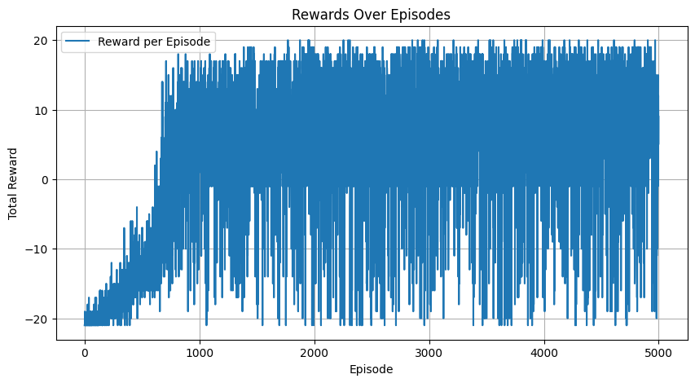
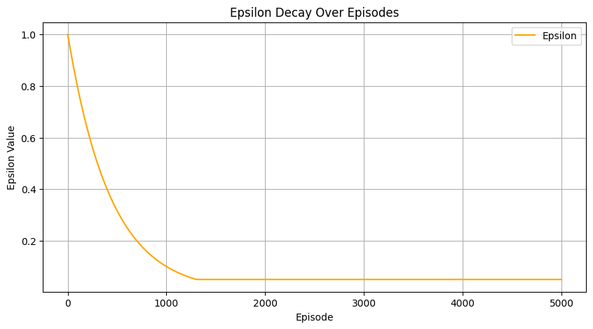
Pong: DQN (Training)

Slide 7
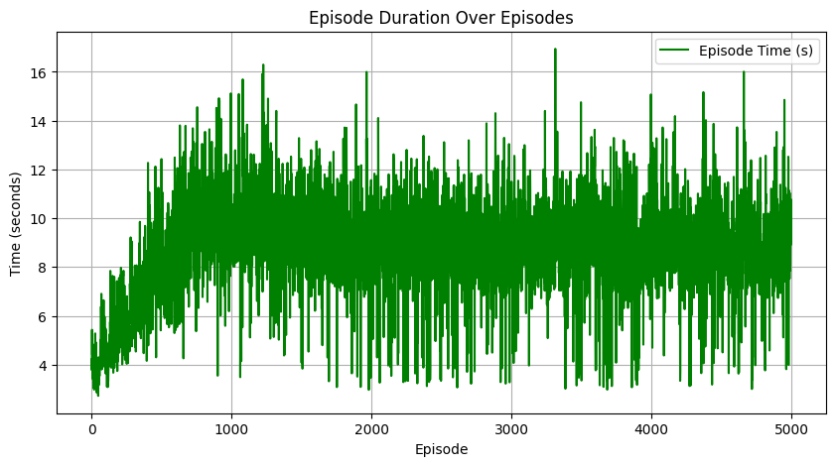
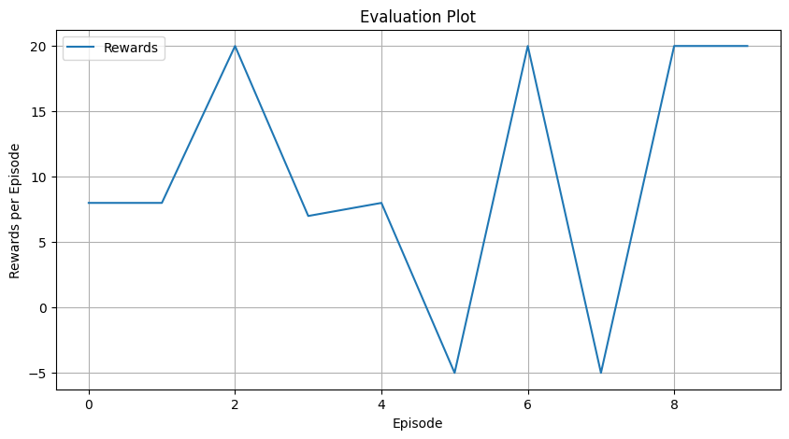
Pong: DQN (Evaluation)

Slide 8
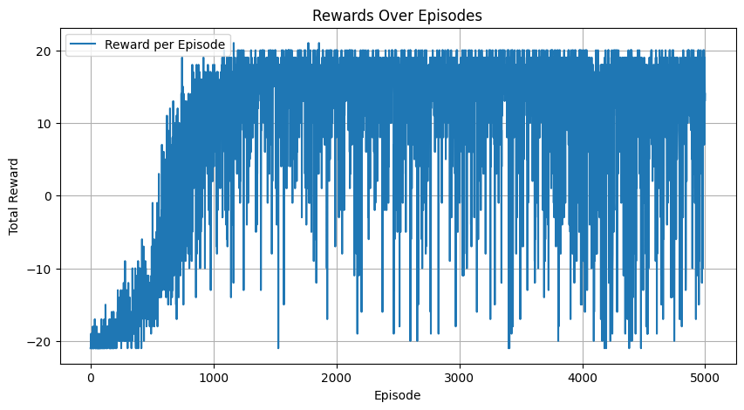
Pong: DDQN (Training)

Slide 9
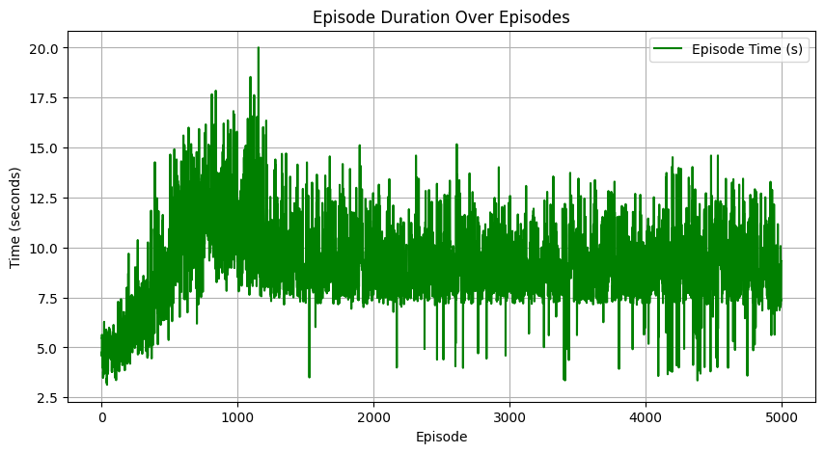
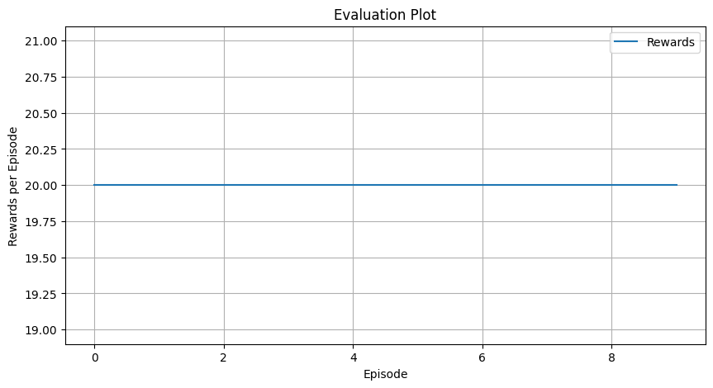
Pong DDQN (Evaluation)

Slide 10
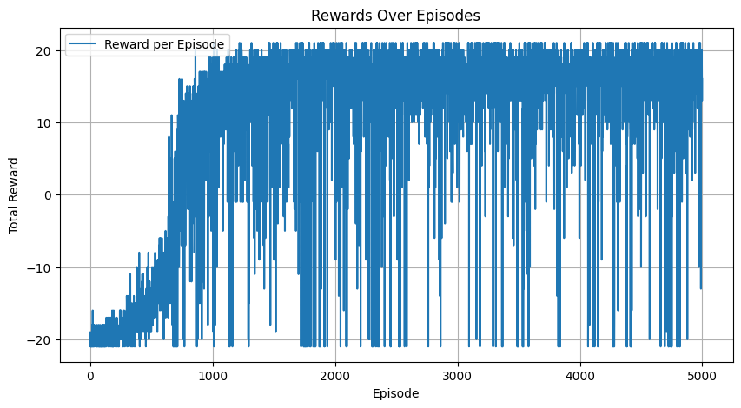
Pong: Dueling DQN (Training)

Slide 11
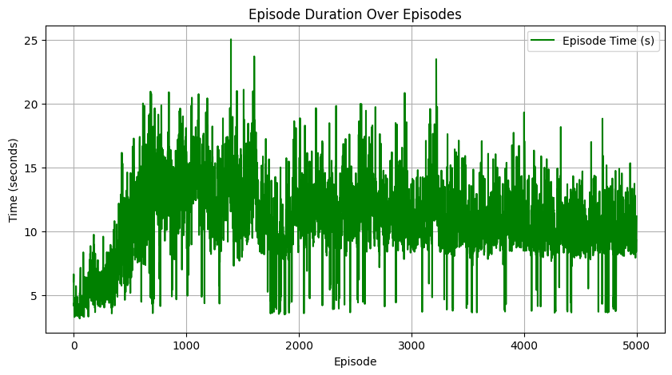
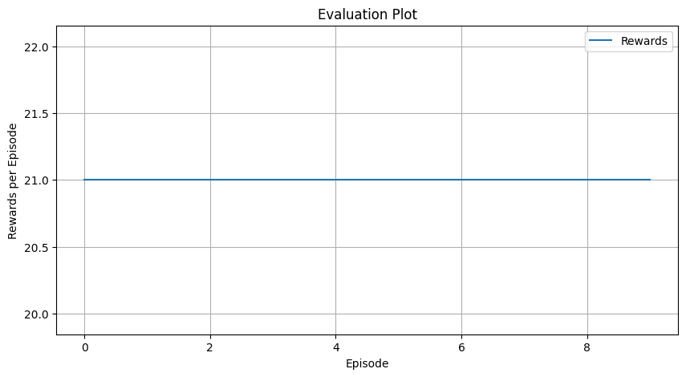
Pong Dueling DQN (Evaluation)

Slide 12
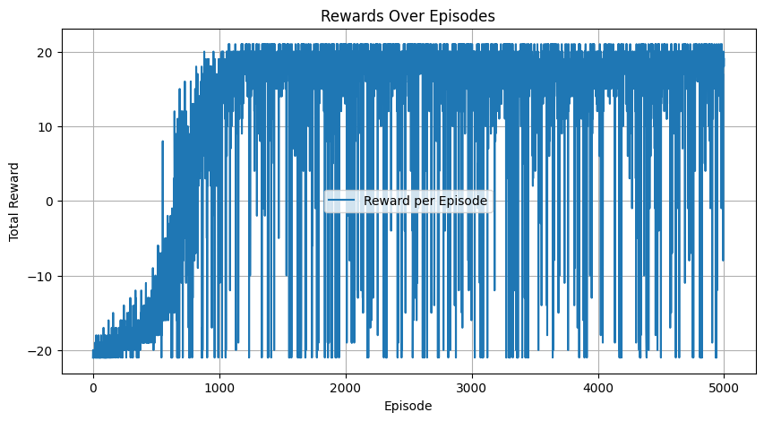
Pong: Rainbow DQN (Training)

Slide 13
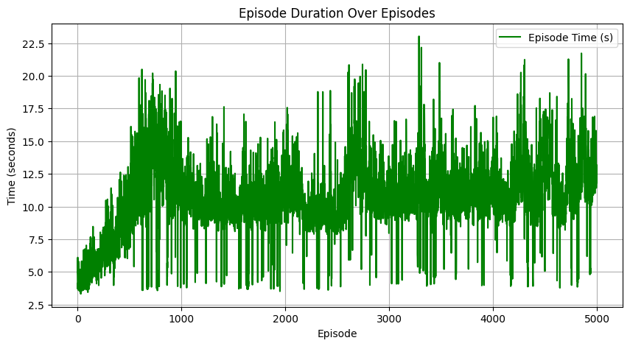
Pong: Rainbow DQN (Evaluation)

Slide 14
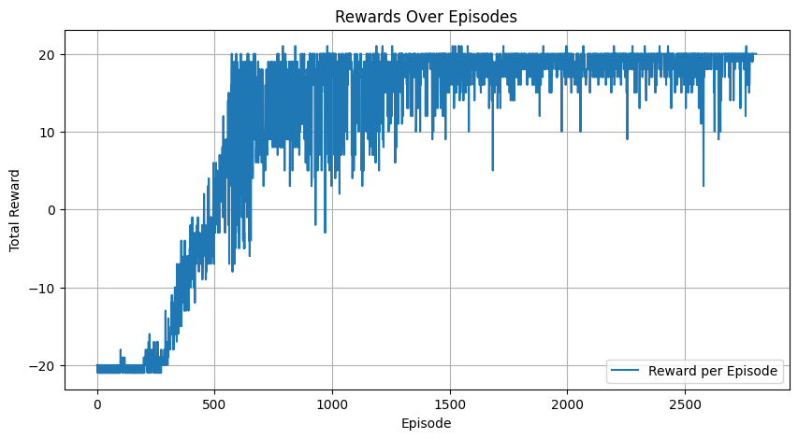
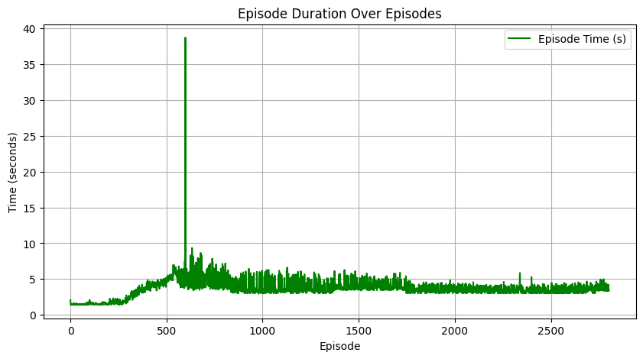
Pong: PPO (Training)

Slide 15
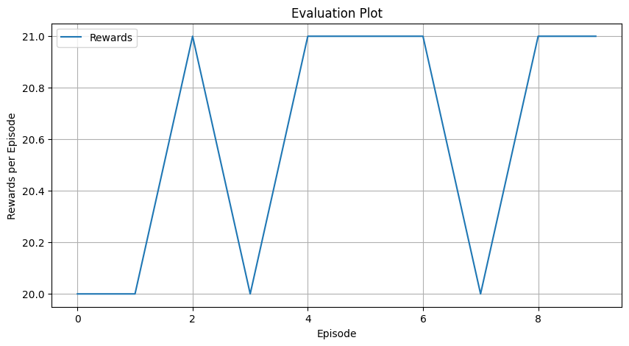
Pong PPO (Evaluation)

Slide 16
Summary Table
Algorithm | Stability while training | Early Stopping | Evaluation Average Reward
DQN | Highly Unstable | No | 10.1
DDQN | Slightly Stable | No | 20
Dueling DQN | Moderately Stable | No | 21
Rainbow DQN | Moderately Stable | No | 21
PPO | Highly Stable | Yes | 20.6

Slide 17
Demo

Slide 18
Challenges

Slide 19
Contribution Table

